Slide 1

CUSTOMER RETENTION PROJECT
Submitted By:
RAUSHAN kUMAR

Slide 2
Contents
Problem Statement
Data Analysis
Pre Processing Pipe Line
Conclusion

Slide 3
Problem Statement
Customer satisfaction has emerged as one of the most important factors that guarantee the success of online store; it has been posited as a key stimulant of purchase, repurchase intentions and customer loyalty. A comprehensive review of the literature, theories and models have been carried out to propose the models for customer activation and customer retention. Five major factors that contributed to the success of an e-commerce store have been identified as: service quality, system quality, information quality, trust and net benefit. The research furthermore investigated the factors that influence the online customers repeat purchase intention.

Slide 4
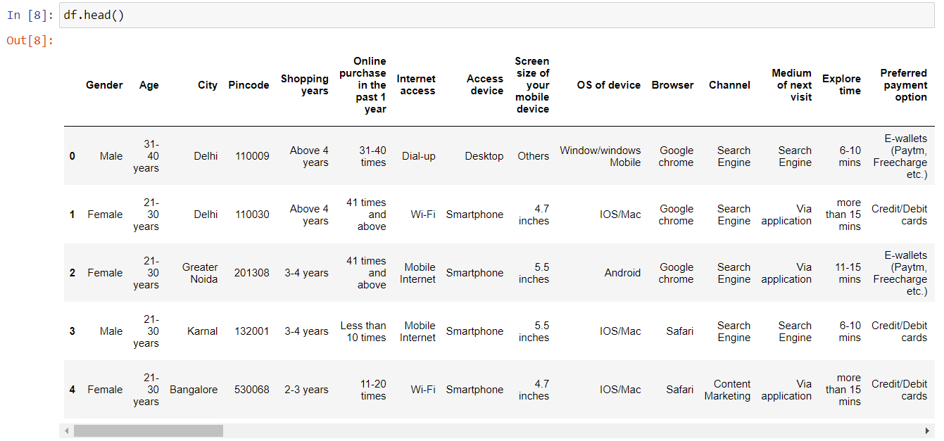
Data Analysis
The dataset contains 269 rows and 71 columns . Each column is categorical and also having
Four to five categories in each column.

Slide 5
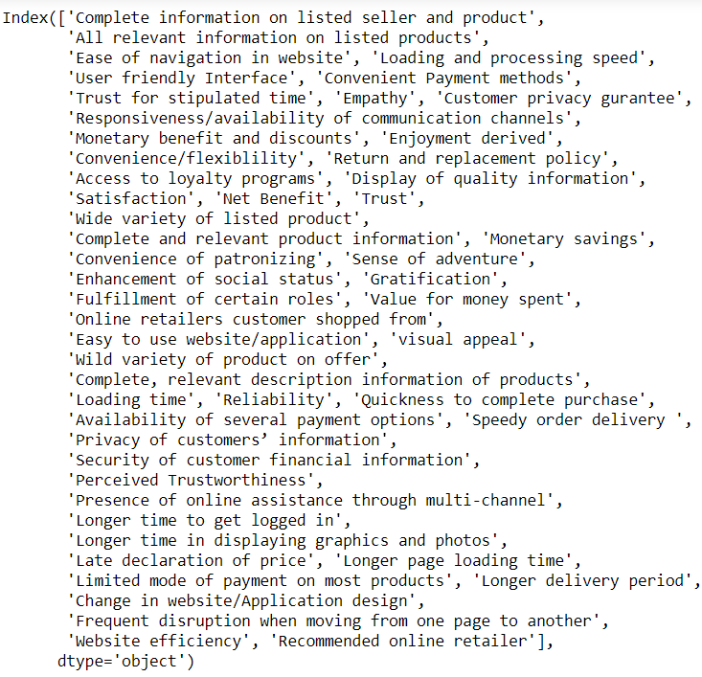
Columns of the Dataset

Slide 6
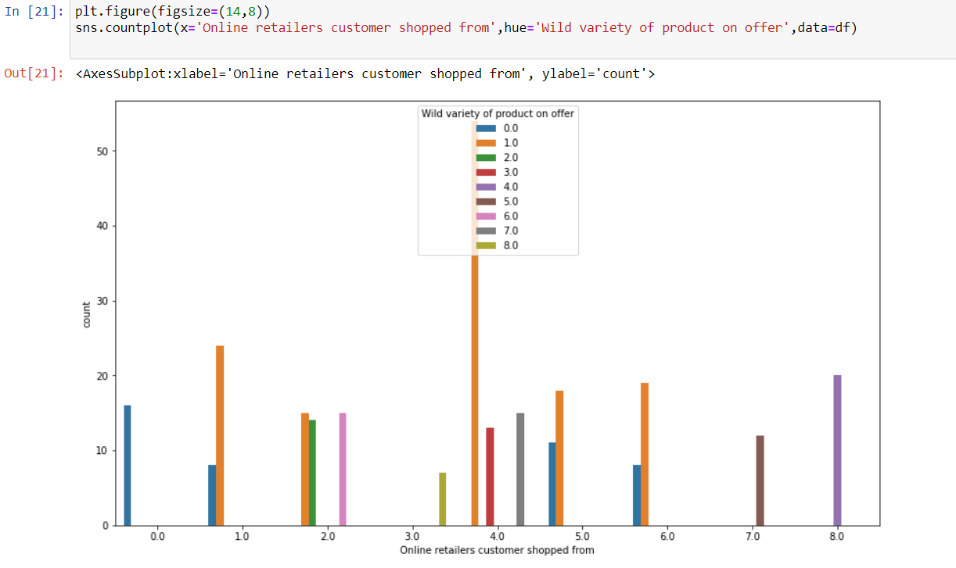
Glance at the Bi variate Analysis
Wide variety of product on offer

Slide 7
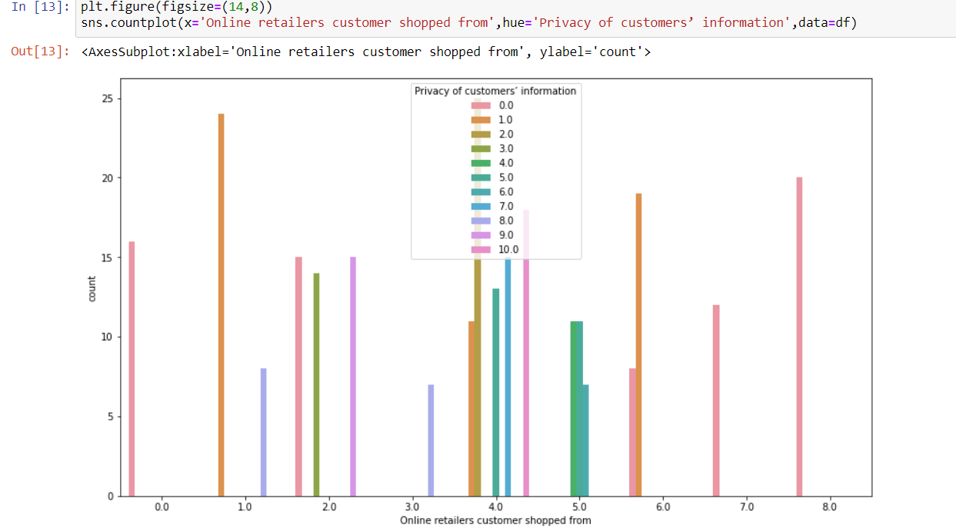
Conti….
Privacy of customer’s information

Slide 8
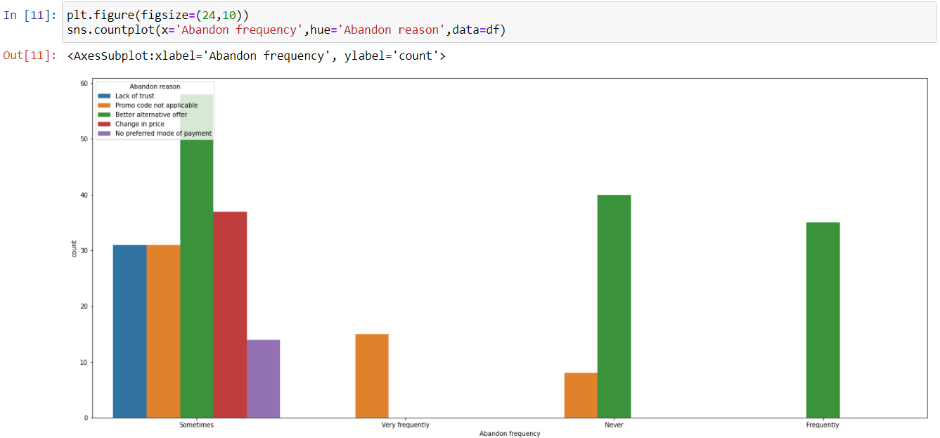
Abandon Frequency with its reason

Slide 9
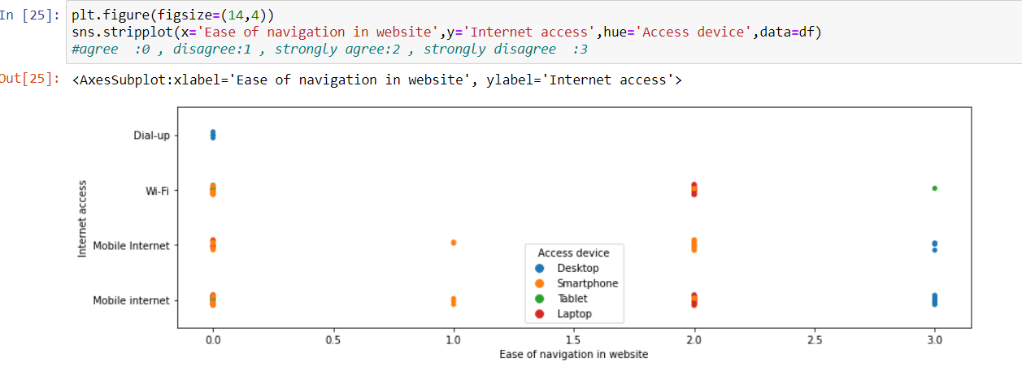
Navigation with internet access

Slide 10
Pre-Processing Pipe Line
Pre Processing is an important step to get better results.
Following are the steps I followed in the project for pre-processing:
Check and handle null values..
Encoding of categorical feature.

Slide 11
Approaches For Pre Processing
No Null values were there in the dataset.
For encoding some columns I used ordinal encoder.

Slide 12
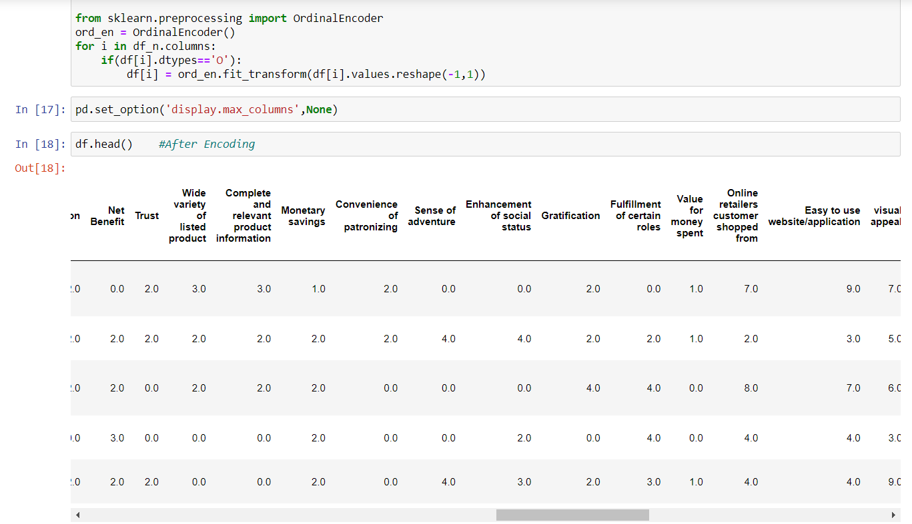
Dataset after Pre Processing

Slide 13
Conclusion
All the columns are categorical. In categorical columns, the categories are somewhat imbalance .
Looking at the type of customers there are customers who are of age 21 to 31 who are females and 31 to 41 who are males.
Customers use mainly smartphones and mobile internet for online shopping.
Main cities are Noida , Delhi and Bangalore from where customers do shopping.
Based on the trustworthiness the amazon and flipkart at the top.
Snapdeal Lack in the privacy of the customer.
Amazon is the only website that is single website used by some customers.
Most preferred payment option is cash on delivery.

Slide 14
Conti..
Most of the people do not shop the added product because of the
Promo code non applicability or better alternative option.
That means websites should take care of the alternative option in terms of price may be.
Except Amazon every website gives late delivery to the customers using it from long time which is not a good practice.
Customers who are using desktop are strongly disagree with ease of navigation of websites reason may be the websites portability or internet issue.

Slide 15
THANK YOU

